Slide 1
How to Use PowerPoint
And how not to use it!

Slide 2
What is Powerpoint for?
Digital presentations
Research presentations
Lectures
Sales pitches
Picture slide shows

Slide 3
What can Powerpoint do?
It can display:
Pictures
Audio
Video
You can manipulate:
Fonts
Backgrounds
Slide transitions
Custom slide animations

Slide 4
A good Powerpoint Presentation:
Portrays ideas in a logical order
Has as few words as necessary
Has interesting and appropriate graphics for every slide
Is not too crazy!

Slide 5
Exercise 1: Basic Formatting
Click on your first slide
Type your name in the first box
In the second box, type your school name, your teacher’s name, and the data
Highlight the text in the boxes, then go to “Format” then “Font” and change the font
Go to “Format” then “Slide Background” and change the color of your slide

Slide 6
Exercise 2: Slideshows
Click “Insert” and then “New slide.”
Have your partner do Exercise 1 on the new slide. Now you should have 2 slides.
Click on the first slide.
In the lower left hand corner, click the little icon that looks like an easel and then scroll through your slides with the rightward-pointing arrow key on your keyboard.

Slide 7
Exercise 3: Inserting Pictures
Minimize your Powerpoint window.
Go to Google Images.
Search for a picture of something you like: animal, sport, car, whatever.
Right click and “copy.”
Maximize your Powerpoint window.
Rick click on the slide where you want the picture and “paste.”
Switch partners and repeat.

Slide 8
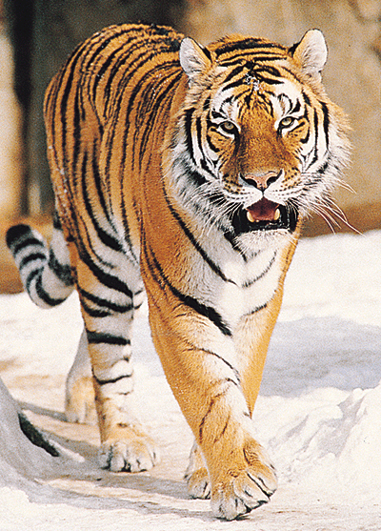
Exercise 4: Manipulating Pictures
Shrink or expand it to the size you want by dragging the boxes in the corner of the picture.
Double click on your picture.
If you need to crop it go to “View” then “Toolbars” then “Picture Toolbar.”
Add a border to your picture by changing the settings for lines.
Switch partners and repeat.

Slide 9
Exercise 5: Custom Animation
Use animation to bring text and pictures in and out of one slide without changing the slide
This is very useful for gradually adding text to a slide so it doesn’t look cluttered.
For example, this slide is getting really cluttered.
OMG there is too much going on.
It’s really hard to read!
No more bullet points
Stop! I can’t take it anymore!

Slide 10
Exercise 5: Custom Animation
You can animate the slides however you want
But I don’t recommend that you animate them like this because it is really annoying
And your presentation will look cheesy

Slide 11
Exercise 5: Custom Animation
Go to “Slide Show” and “Custom Animation”
Highlight Your name
In the Custom animation box, click “Add effect” and select an Entrance effect
Now highlight each line of the second box (with the school, teacher, and date) separately and “Add effect” to each one
For each effect, you can manipulate when it “Starts” and how fast it happens. Play with those settings.
To see your finished product, click the little easel icon and then the arrow key.

